Slide 1
An overview on Chikungunya Infection

Slide 2
Is an Viral illness caused by an arbovirus transmitted by the Aedes mosquitoes. In 1952 the disease was documented first time in the form of outbreak in Tanzania.
Chikungunya is Makonde originated word which means “ That which bends up”. Referred to stooped posture resulting from arthritic symptoms.

Slide 3
Causative Agent:
Chikungunya Virus
# It is a single stranded, heat labile, RNA virus having distinct genotype and antigenic characteristics.

Slide 4
Vector:
Aedes Aegypti
Aedes Albopictus
A.Aegepti is the common vector responsible for urban transmission whereas A.Albopitus has been implicated in rural areas.

Slide 6
MODE OF TRANSMISSION
By Infected Female mosquitoes.
They bite usually during day time.

Slide 7
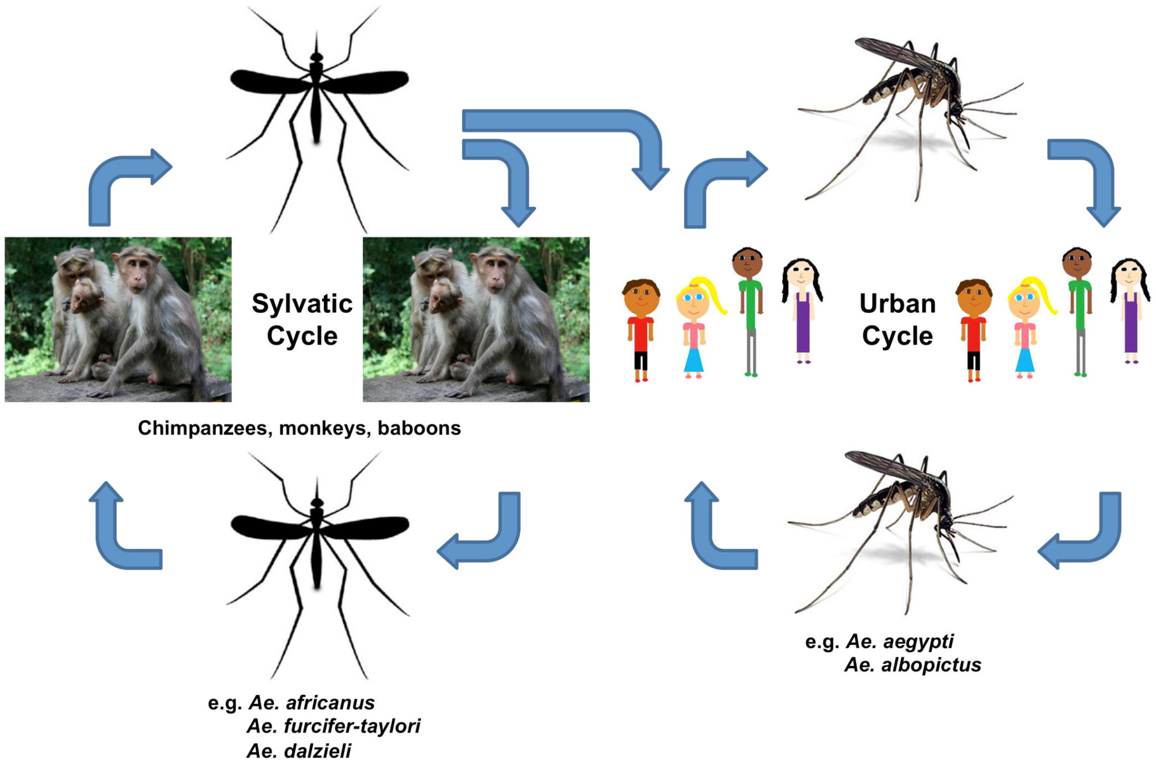

Slide 10
Clinical Features:
Incubation period: 2-6 days
Symptoms and Signs:
Usually begin 3-7 days after bitten by an infected mosquito. The most common symptoms and signs are-
Sudden onset of high grade fever with chills
Athralgia/Athritis
Severe headache
Myalgia
Generalized itching (with or without skin rash)
Flushing of face

Slide 11
Continue…
Persistent joint stiffness
Painful joint movement
Tendinitis
Skin pigmentation
Gum bleeding
Appearance of tender lymphnodes

Slide 12
Sign and Symptoms (phases):
Clinical presentation of Chikungunya usually follows 3 phases which are as follows:
Acute Phase (<3 weeks):Followed by abrupt onset of signs and symptoms.
Subacute phase(>3 weeks to 3 months):Followed by generalized weakness, polyathralgia,blackening of skin folds,joint stiffness.
Chronic phase(>3 months):followed by Athritis,reccurant joint swelling after each episode of any fever,reccurant joint pain.

Slide 13
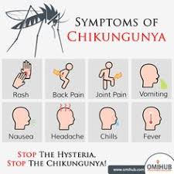

Slide 14
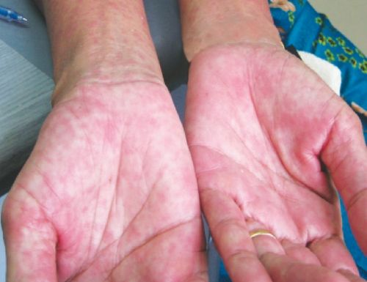
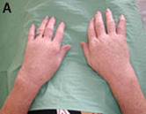
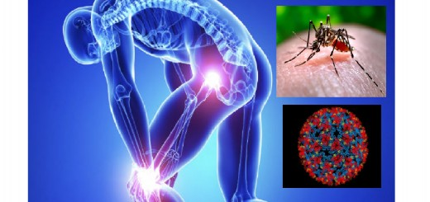
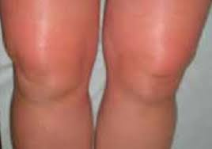

Slide 15
Rare But Serious Complications:
Acute encephalopathy
Dementia
Retinitis
Uveitis
Myocarditis
Intestinal Hemorrhage

Slide 16
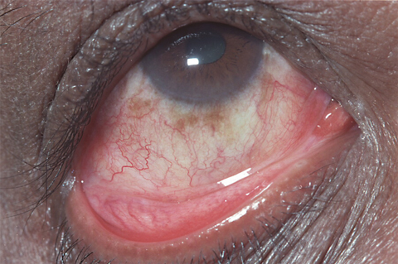

Slide 17
High Risk Group:
Geriatric age group and paediatric age group.
Any co morbid conditions (DM, HTN,CVD,COPD,Hypothyroidism)
Pregnancy
Any Co-Infection(Dengue,TB,Enteric Fever,HIV,Malaria)

Slide 18
Few common features for D/D of Chikungunya fever from dengue fever:
Sl no. | Features | Chikungunya | Dengue
1. | Fever *onset | Acute (2-4 days) | Gradual (5-7days)
2. | Chronic phase | Present | Absent
3. | Skin change | Flushing followed by blackening of skin folds,maculopapular rashes | Petechiae maculopapular rash purpura
4. | Athralgia | Frequent,may persist over a long period | Less common,short duration
5. | Tenosynuvitis | Common | Not seen

Slide 19
Sl no. | Features | Chikungunya | Dengue
6. | Conjunctival irritation | Common | Rare
7. | Leukopenia | Common | infrequent
8. | Lymphopenia | Common | infrequent
9. | Thrombocytopenia | infrequent | Common
10. | Hematocrit | Normal | High
11. | Bleeding,Hypotension | Rare | Common
12. | Dehydration | Common (After 7 days) | Common in whole period

Slide 20
Investigations:
A definitive lab diagnosis can be accomplished through three main lab test:
Serological test (IgM,IgG,MAC-ELISA)
Virus Isolation
RT-PCR

Slide 22
As the clinical manifestations of Chikungunya fever resemble those of Dengue and other arthropode borne viruses of Alphavirus genus, Lab diagnosis is critical to establish the cause..

Slide 23
Serological Diagnosis:
ELISA assay to measure Chikungunya-specific IgM levels in the blood serum.
Chikungunya antibody tests are generaly appropriate after the first week of symptom onset and onward.
An acute phase serum must be collected immediately after the onset of illness and the convalesent phase serum 10-14 days later..Diagnosis can be made by demonstration of four-fold rise in antibody titre in acute and convalesent serum.

Slide 24
RT-PCR:
Appropriate in the early days of symptom onset, since CHIKV RNA can be detected during the acute phase of illness(<8 days after symptoms onset).It can also be used to quantify the viral load in blood.

Slide 25
Virus Isolation:
Virus isolation provides the most definitive diagnosis. But takes 2 weeks for completion. And must be carried out in biosafety level-3 laboratories.
Not available in our country.

Slide 26
Management
Treatment for Chikungunya infection is purely symptomatic. There is no antiviral drugs against it. Most of the Signs symptoms are self limiting.

Slide 27
Outline of management:
Domiciliary : *Adequate rest,Tepid sponging
*Paracaetamol 500mg TDS/QID [Doesn’t exceeds 3gm/day]
PPI/H2 blocker to counter gastritis.
Antihistamins from 4th or 5th days as itching starts from that day.
Cold compresses to involve painful joints. Avoid hot fomentation in acute stage as it can worsen joint symptoms.
Non weight bearing exercise,physiotherapy after 2 weeks.
Avoid antibiotics,steroids,Aspirin.

Slide 28
When to seek medical help:
If fever persist >5 days.
Intractable joint pain.
Postural dizziness, cold exrimities.
Altered sensorium
Any bleeding under skin, gum bleeding or through any orifice.
Decrease urine output.
Incessant vomiting.
Jaundice.

Slide 30
Drug treatment
Acute phase drugs:
Analgesics:
Dipyrone, Paracetamol:
These are good analgesics when administered in appropriate doses and at regular interval.
Paracetamol can be prescribes at 500-750 mg --- 6 hourly .
Opioids:
*Potent and safe analgesics
*Patient sould be warned about adverse effect
*Tramadol is a good choice when suspicious of a neuropathic component of intense pain.

Slide 31
NSAIDS and Acetylsalicylic acid: Despite inflammatory component in the physopathogenesis of the disease, NSAIDS should not be used due to the risk of hemorrhage and renal insufficiency.
Corticosteroids: These can be used only in acute phase of viraemia.

Slide 32
Subacute phase
NSAIDS (Ibuprofen) 600 mg orally 8 hourly.
Prednisone 0.5/kg/day (maximum 40mg can be used) After resplution of symptoms this dose should be continue for 3-5 days and begin weaning by 5mg/day every 7 days.

Slide 33
Chronic phase Drugs:
Hydroxychloroquine 6mg/kg orally once daily for 6 weeks.
If doesn’t improved then add Sulfasalazine 1 gm 12 hourly orally 6 weeks.
After these medication if pt doesn’t improved then change the drug to Methotrexate 15-20mg once a week orally for 6 weeks.

Slide 34
For dermetological manifestations-locally zinc oxide or calamine, oral or injectable anti histamins can be given.
To manage neurological problems Amitryptiline,Carbamazepine,Gabapentine can ne prescribed

Slide 35
Prevention strategies
Primary prevention: Use air conditioning, use window screen, mosquito net, maintain clean environment to discourage mosquito breeding grounds, wear clothes covering most skin to minimize exposed regions.
Secondary prevention: Avoid mosquito bite during acute phase.

Slide 37
Thank you all….

